Slide 1


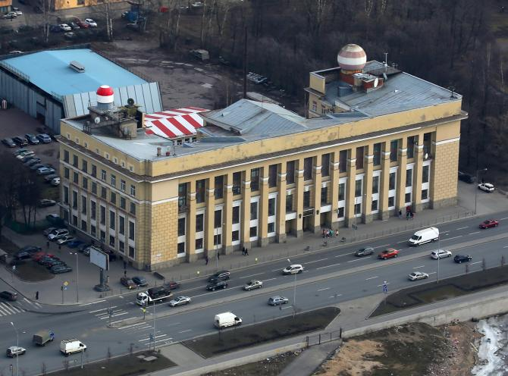
Russian State Hydrometeorological
University RSHU
Institute of Hydrology and Oceanology
Department of Engineering Hydrology
APPROBATION OF ACHIEVEMENTS OF SCIENTIFIC SCHOOLS IN THE EDUCATIONAL BUREAU OF HYDROLOGICAL FORECASTS AND THE LABORATORY OF HYDROLOGICAL CALCULATIONS
November 24, 2021, St. Petersburg

Slide 2
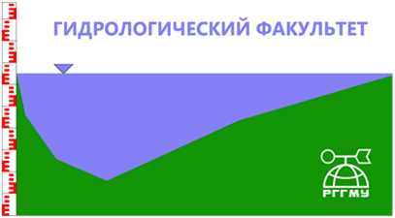
Russian State Hydrometeorological University (RSHU)
1930 — was organized as the Moscow Hydrometeorological Institute
1995 — received the status of the Regional meteorological educational center of the World Meteorological Organization (WMO) according of the Agreement between the Government of the Russian Federation and the WMO
1998 — received the University Status
Historically had 3 related faculties:
Meteorological, Hydrological and Oceanological
Hydrological Faculty consists of four Departments:
Geodesy and Hydrogeology
Hydrological Measurements
Land Hydrology
Hydrophysics and Hydrological Forecasts

Slide 3
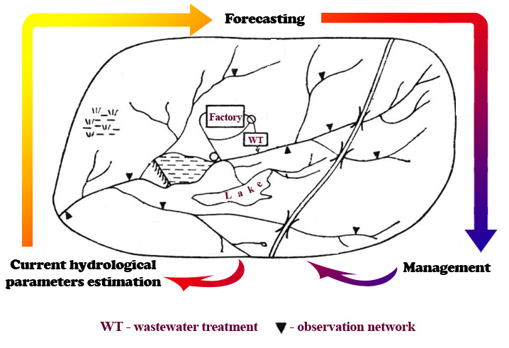
Currently, the Department of Engineering Hydrology unites two departments: Land Hydrology, Hydrophysics and Hydrological Forecasts.
Hydrology studies a River Basin or an entire Water-Management Сomplex (WMC)
WMC includes a River Basin and Water Related Constructions situated here (Hydropower Plants, Water Reservoirs and etc.)
Current data on WMC allows
forecasting its future condition
Estimating current hydrological characteristics
of streamflow and their spatiotemporal distribution
Forecasting data allows managing WMC,
for example:
seasonal or multiyear runoff regulation

Slide 4
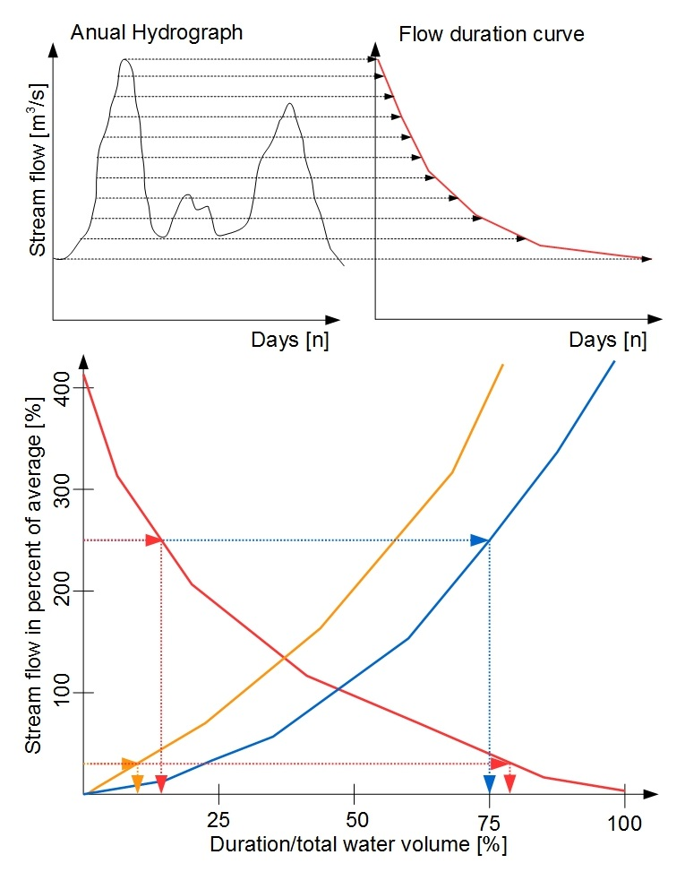
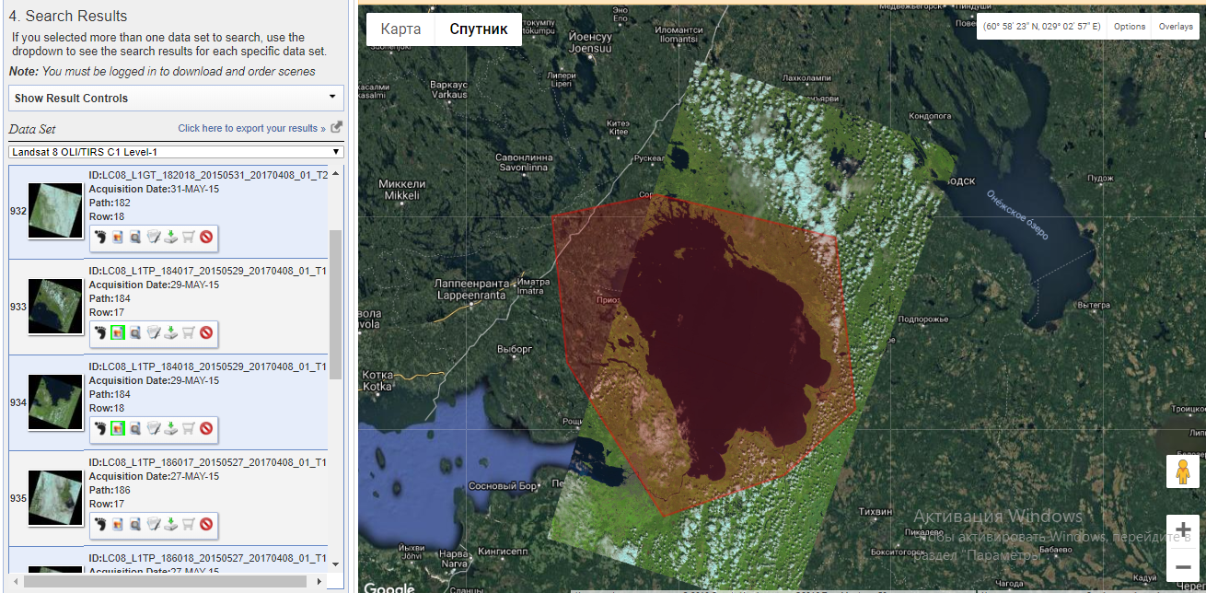
The direction of Land Hydrology

Slide 5
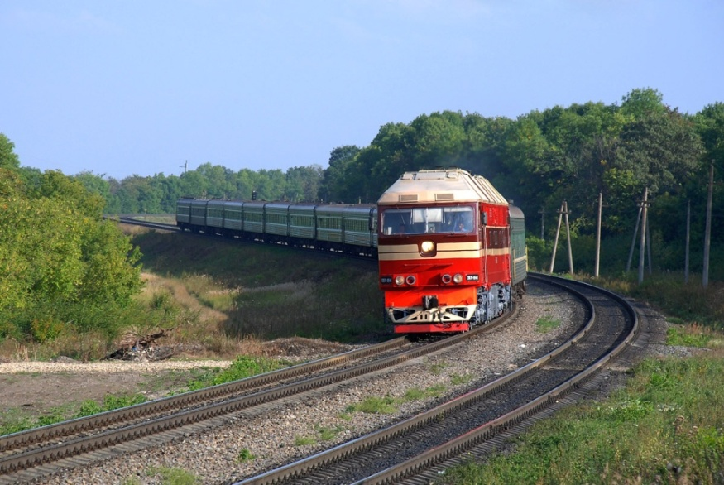
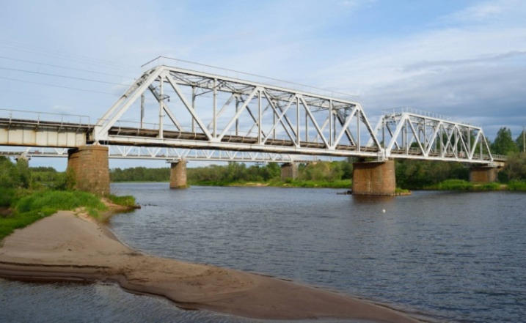
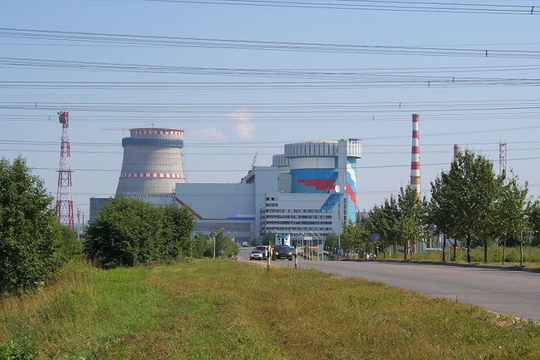
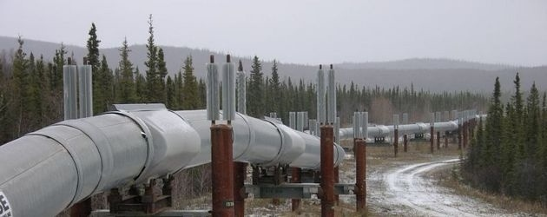
Major Research Areas
Enhancing of current and development of new methods for calculating
main hydrological characteristics, required for projects and construction

Slide 6
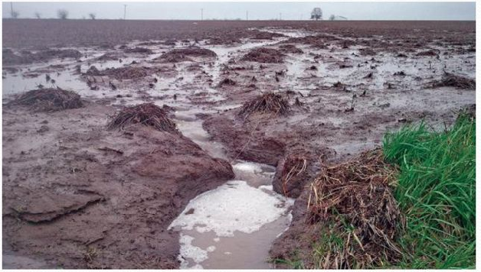
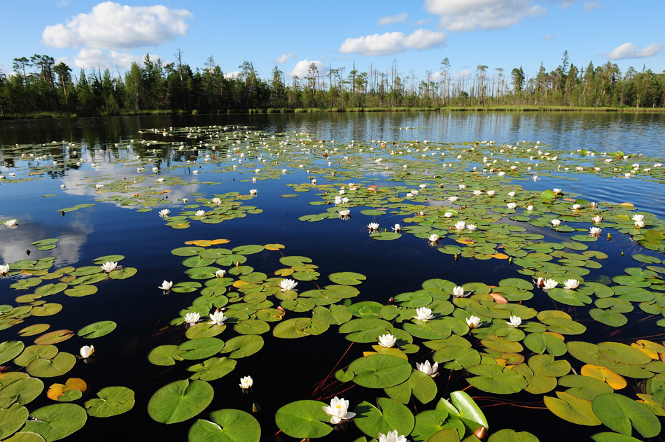
Climate and human activities impact on water resources condition in economically developed regions
Rational water use for sustainable ecosystems
Hydrological regime and external water exchange in different genesis lakes

Slide 7
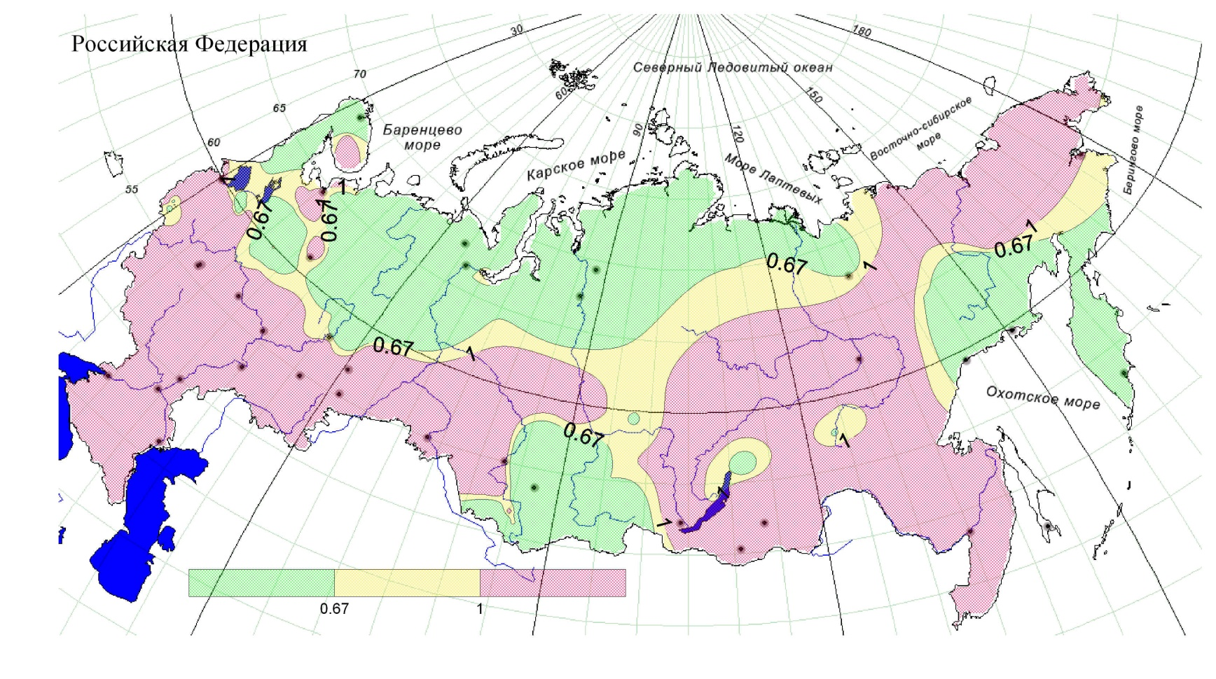
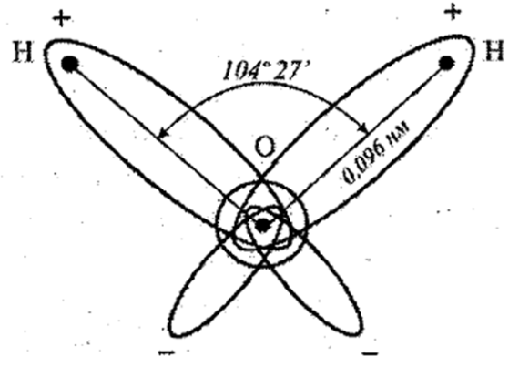
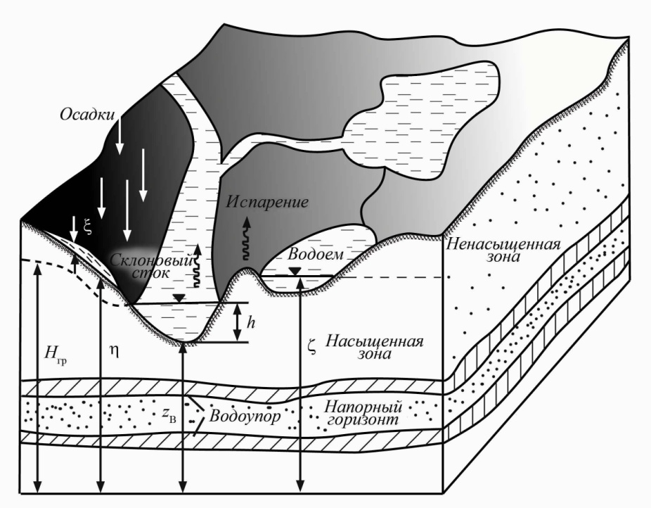
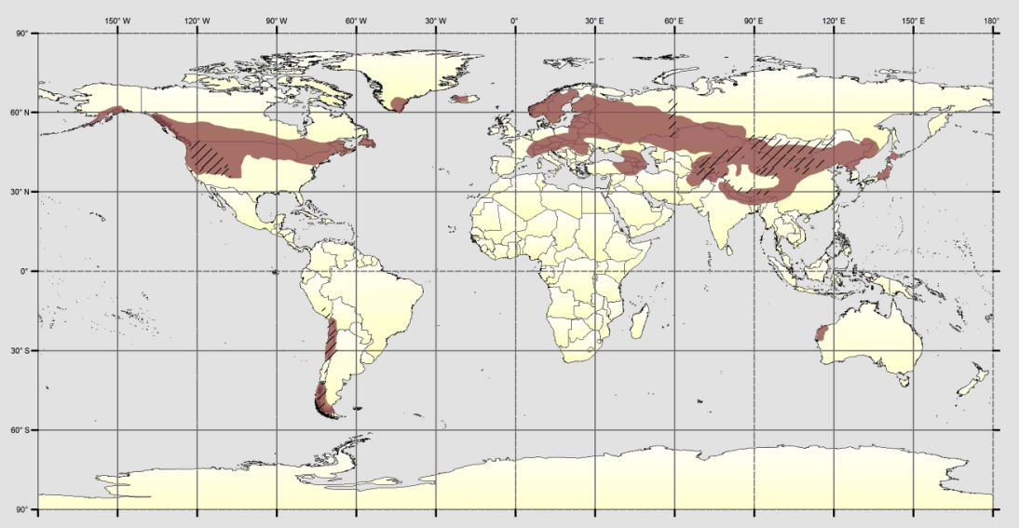
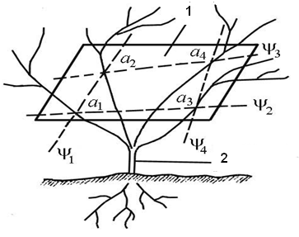
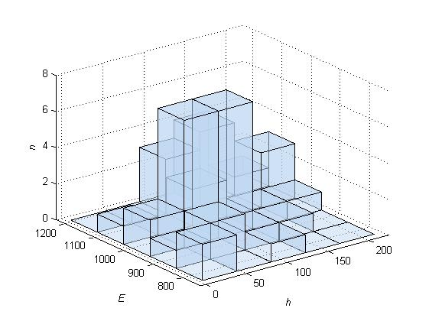
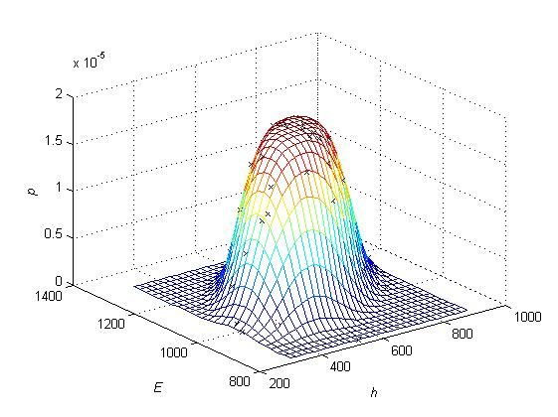
The direction of Hydrophysics and Hydrological Forecasts

Slide 8
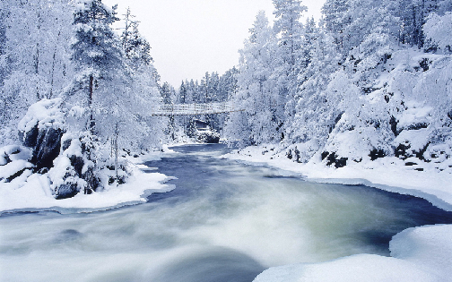
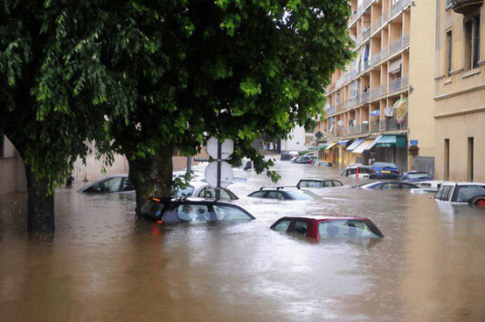
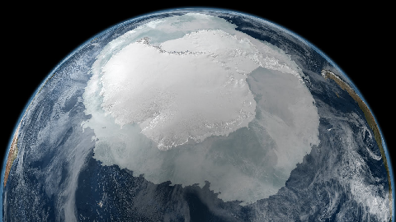
Major Research Areas
Modeling, Forecasting and Management of Hydrological Processes
Estimating the effects of anthropogenic climate change, based on a stochastic model of river flow formation.
Estimating possible ecological and economic effects of unstable process of river flow formation.
Identification of the onset of bifurcation mechanisms of development, considered a hydro-ecological catastrophe (loss of stability), based on analytical and numerical analysis of mathematical models.

Slide 9
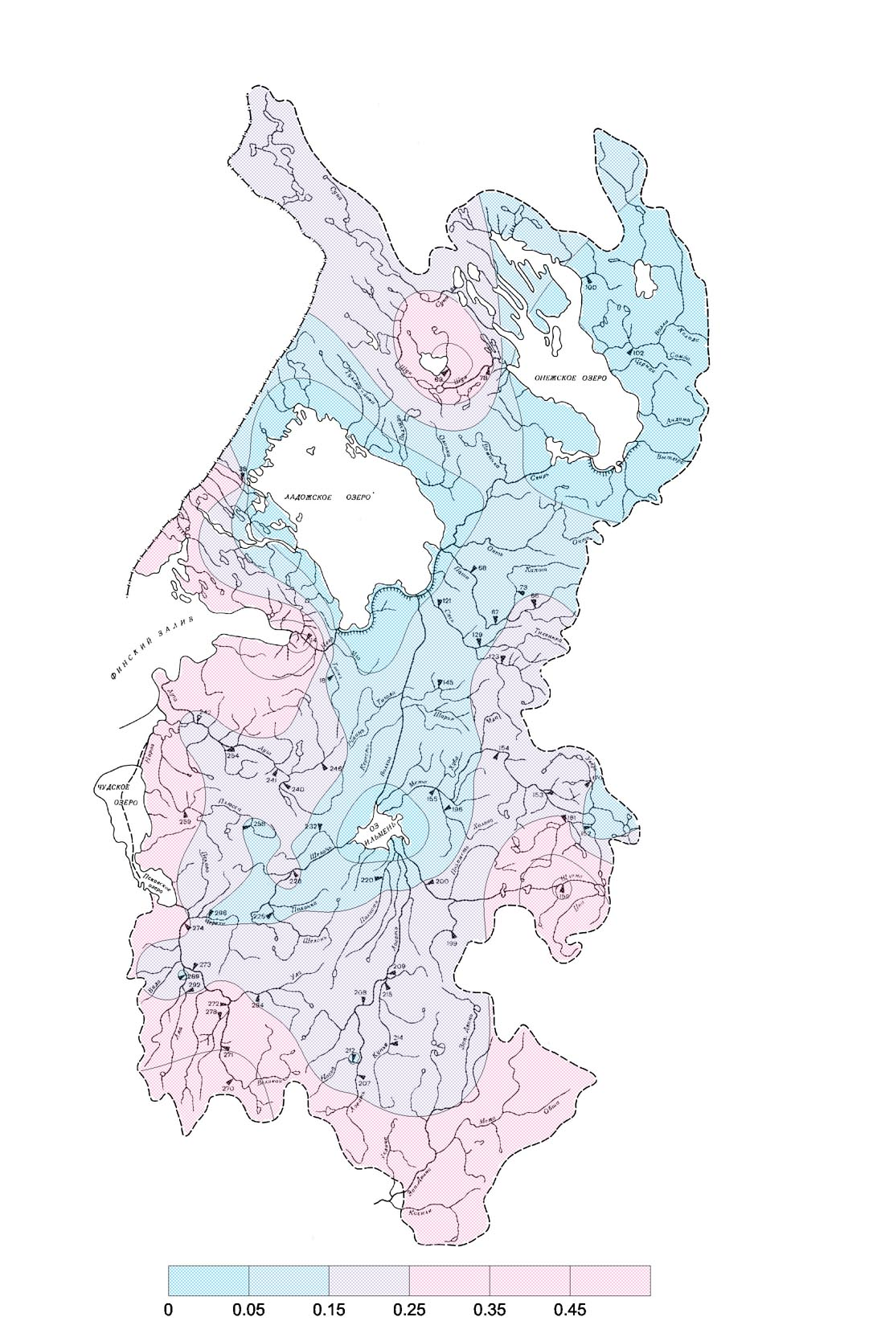
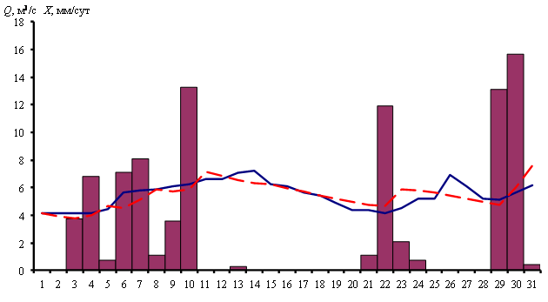
Systematic modeling of deterministic and stochastic processes of water exchange in catchments.
Solving problems of optimal management (control) of the development of hydro-ecological processes.

Slide 10
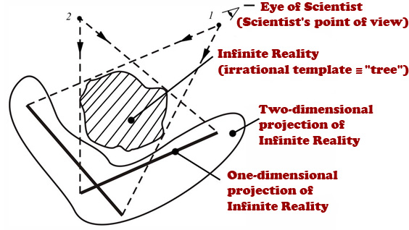
Scientific school Partially Infinite Hydrology
A new scientific approach Partially Infinite Hydrology is targeted on modeling and forecasting the development of hydrological objects (processes) with the use of mathematical apparatus of multidimensional Markov random processes.
The approach
was developed at the Department of Hydrophysics and Hydrological Forecasts;
is based on the use of the methodology for suppressing the instability of the Predictive Modeling Solutions;
is suitable both for short-term (weeks) and long-term forecasting of hydrological effects of climate change.
The fundamental basis for this methodology is fractal diagnosis of hydrometeorological series and «placing» the task at hand in the space of extended dimension. The number of dimensions depends on fractal diagnosis results.
Image of Partially Infinitive Modeling

Slide 11
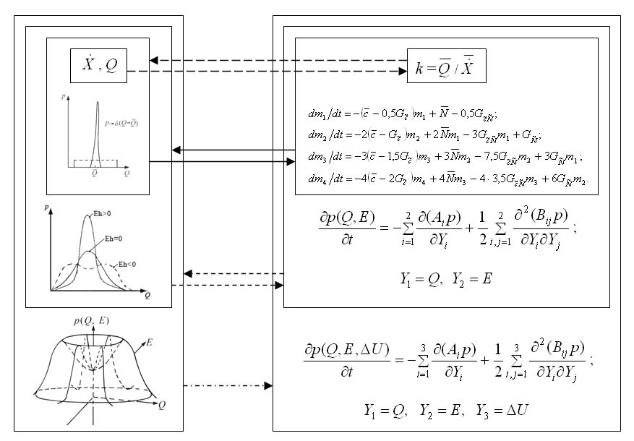
Scientific school Partially Infinite Hydrology
Enhanced methodology for short-term and long-term forecasting of catastrophic phenomena formation conditions, related to hydrological effects of long-term climate change scenarios, is aimed at assessment of both multi-year characteristics and change in the typical course of hydrometeorological elements.
This allows specific short-term scenario
forecasting of possible catastrophic
phenomena.
Perspective applications:
mapping forecasts of hydrological effects of climate change can be used as a means for evaluating economic effects of climate change (through targeted functions).
Use of Partially Infinite Modeling
for assessment of hydrological effects of climate change

Slide 12
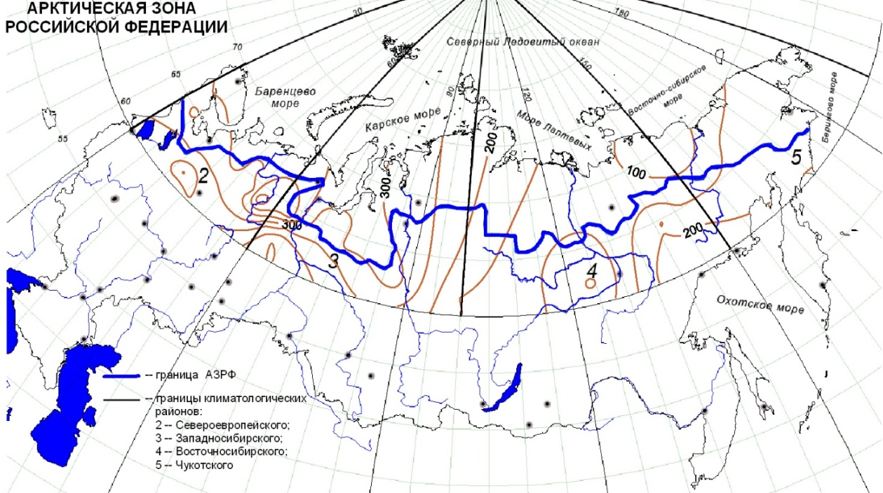
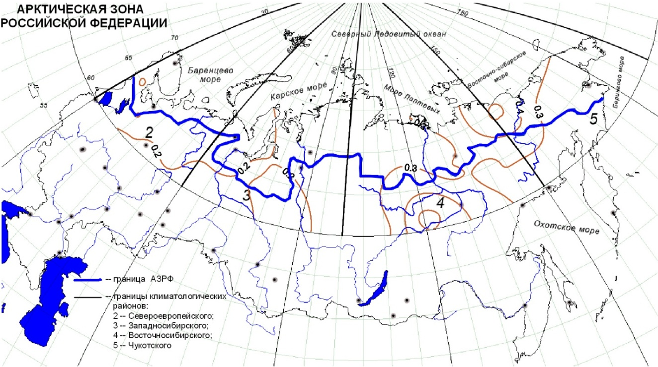
POSSIBILITIES FOR FORECAST THE PROBABILISTIC CHARACTERISTICS OF RIVERS IN THE ARCTIC REGIONS
a)
Arctic zone of the Russian Federation
b)
Distribution of the annual runoff rate h (mm) (a) and the variation coefficient Cv (b) in the Arctic zone of the Russian Federation, calculated on the basis of actual runoff series
The work was funded by the Ministry of Science and Higher Education of the Russian Federation № FSZU-2020-0009.

Slide 13
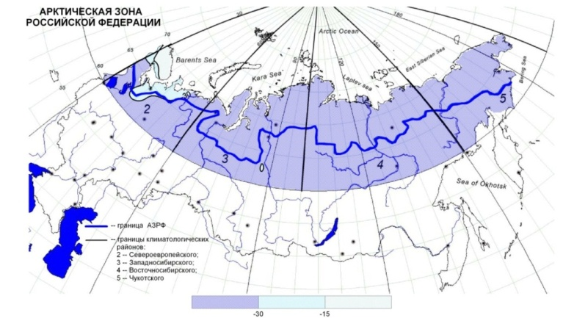
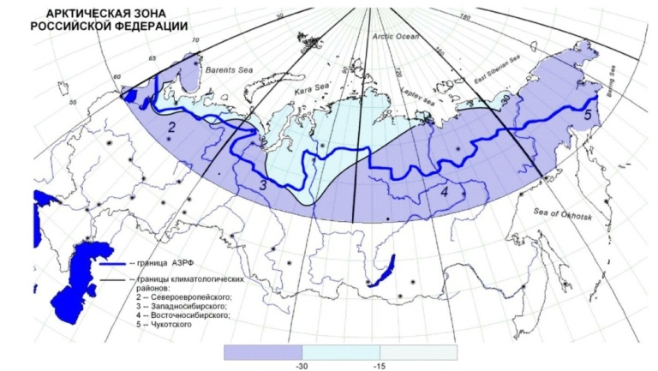
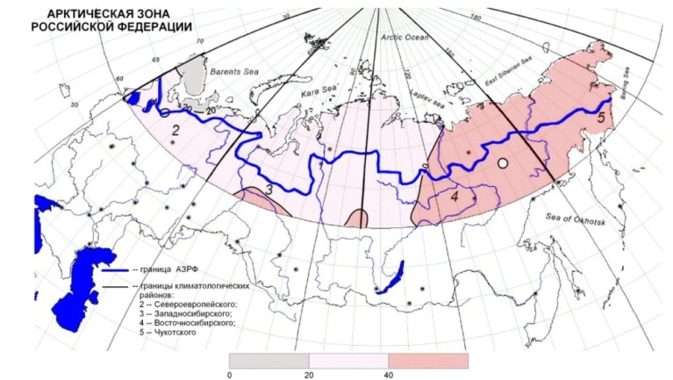
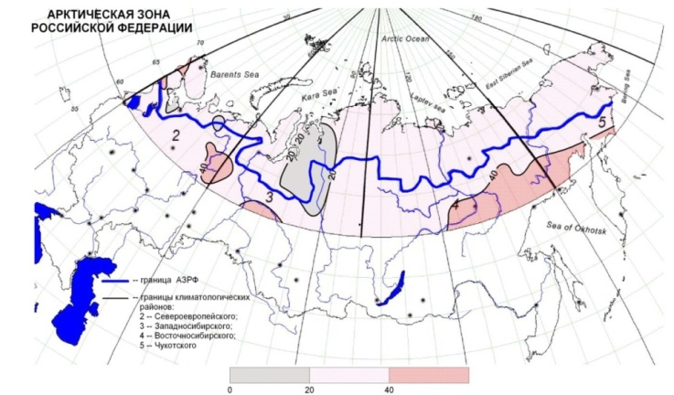
Forecasting Example
Statistically significant deviations between the predicted (2020–2040) and the actual annual runoff rates h (a, c) and the coefficients of variation Cv (b, d) (RTK 2.6 (а, b) и РTK 8.5 (c, d) модель MPI-ESM-MR)
а)
c)
b)
d)

Slide 14
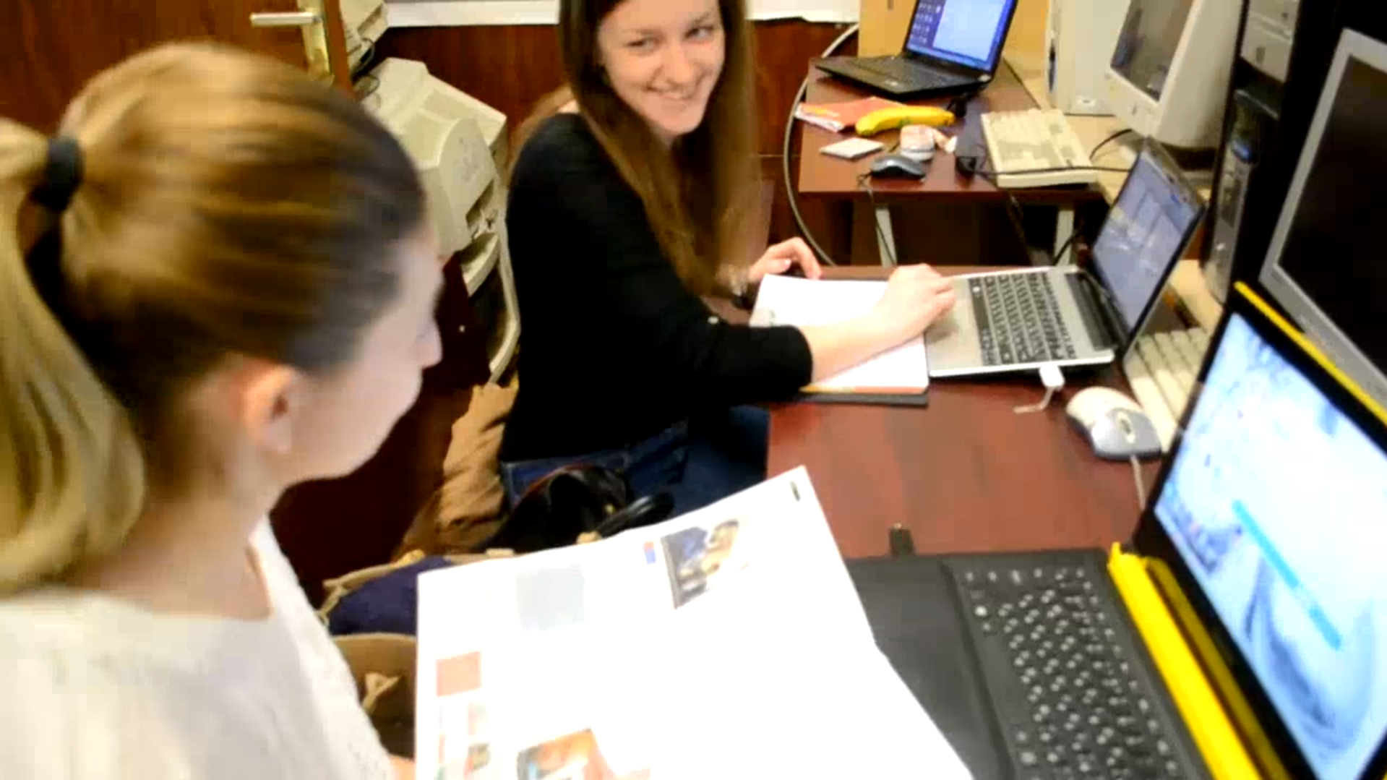
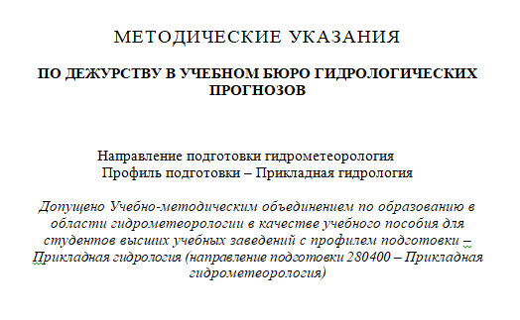
Educational Bureau of Hydrological Forecasts of RSHU

Slide 15
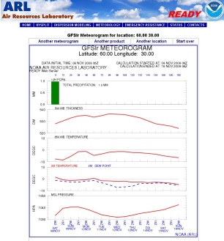
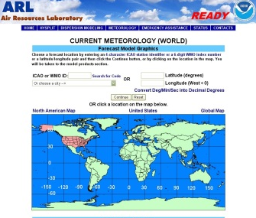
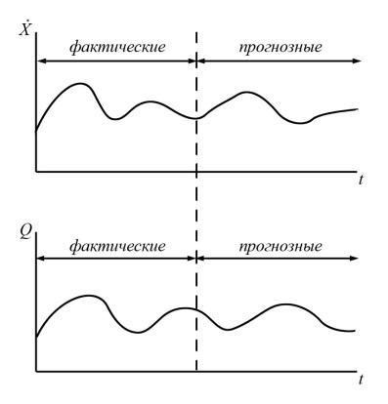
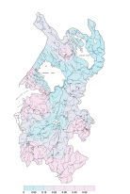
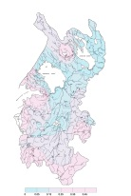
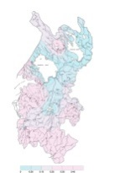
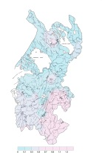
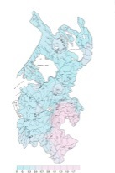


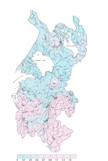

Flowchart of forecast technology
Getting a forecast of weather elements
Optimization of parameters
X, t°
Forecast
for 15 days
for 8 days
Building map charts
Slope drain models
distribution of water content (flow modulus)
First order
Second order
Decoding of KN-15 telegrams
water levels,
daily precipitation,
air temperature

Slide 16
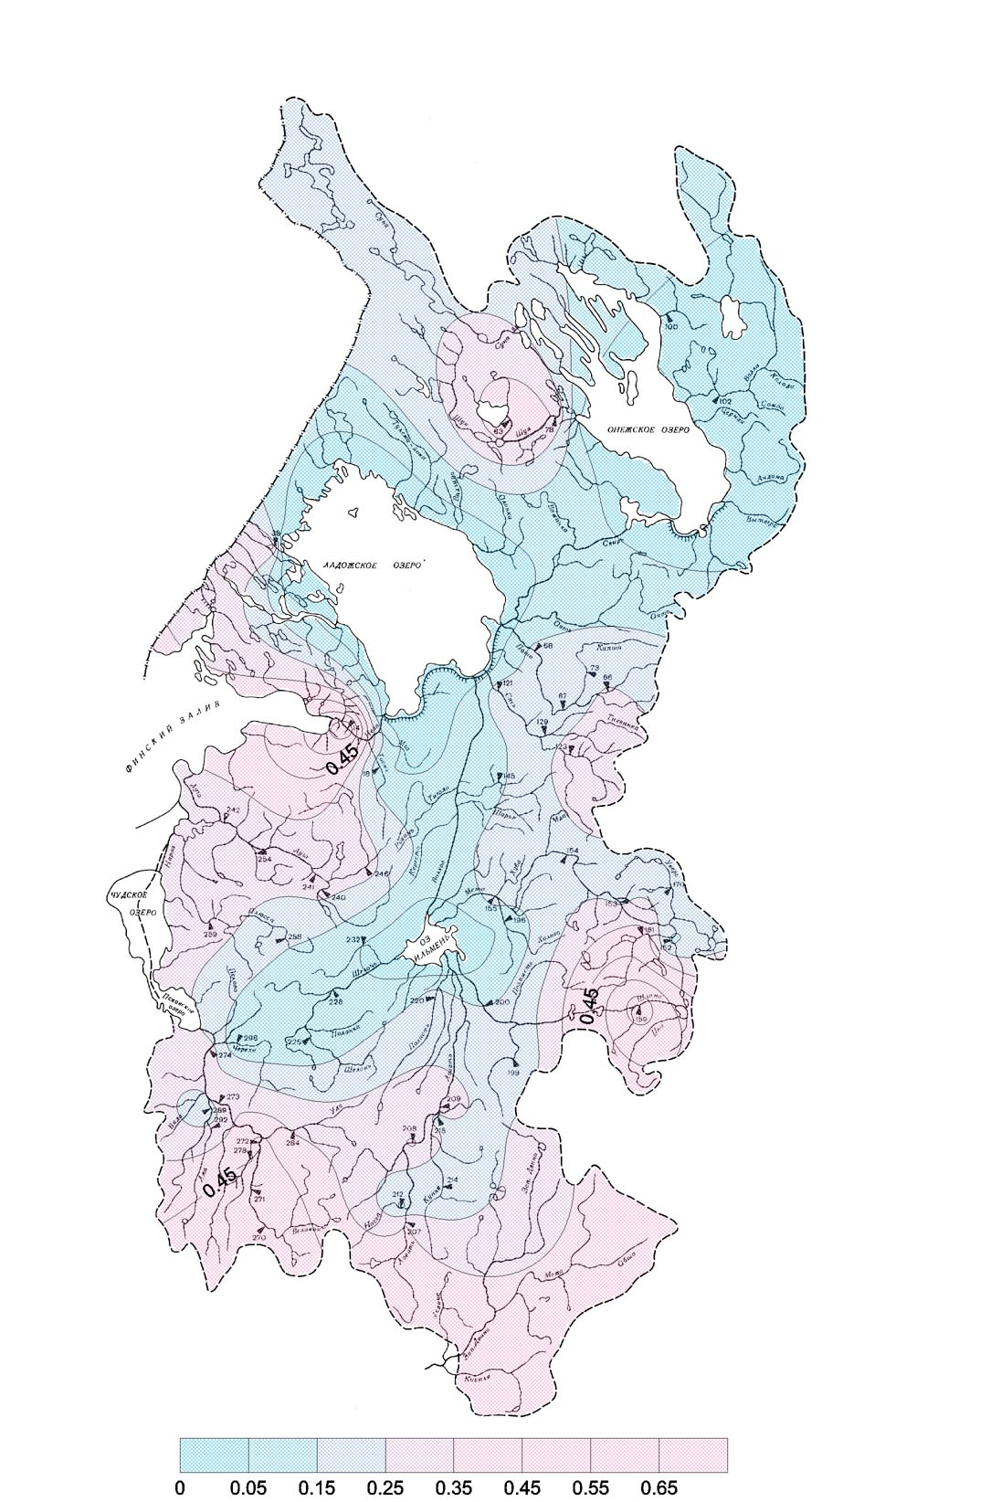


Distribution of water content across the territory of the North-Western region at the initial moment of time, after 4 and 8 days

Slide 17
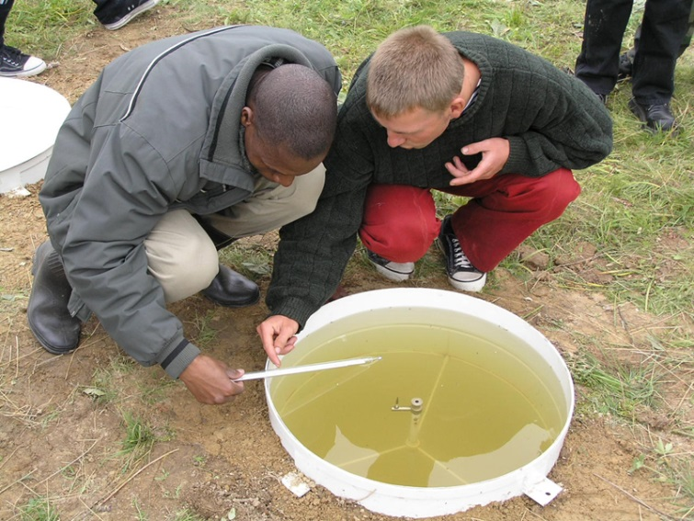
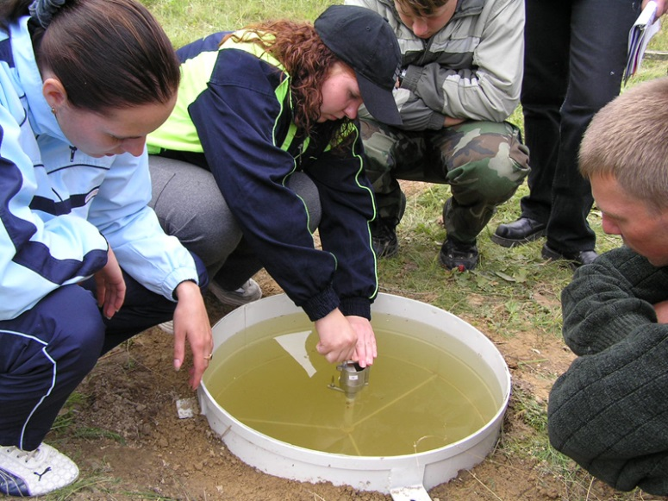

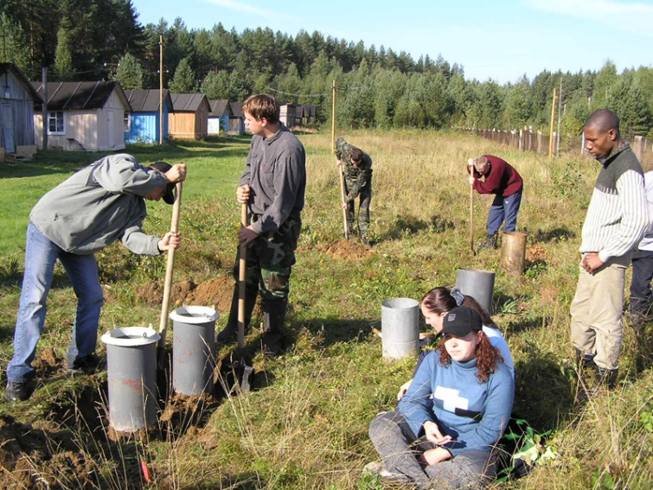
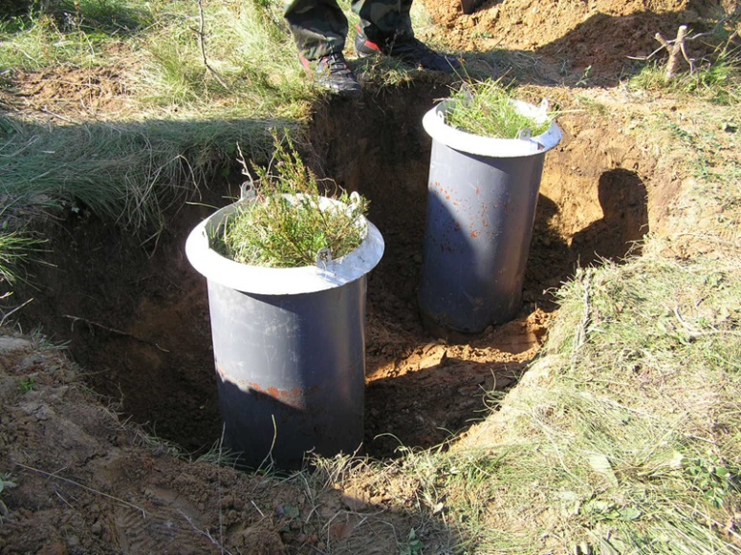
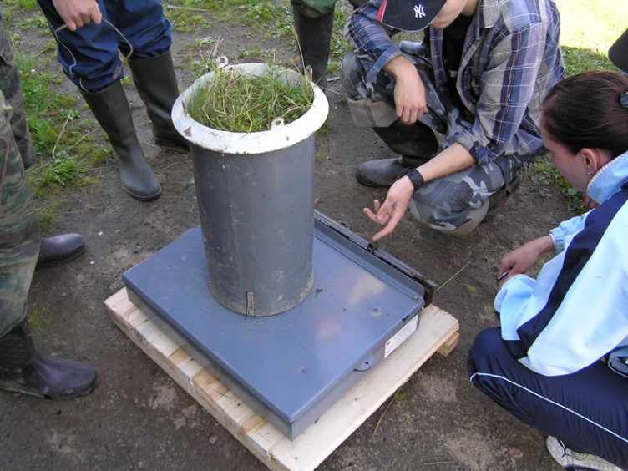
Practice "Land Water Physics"
Water balance observations and modeling of hydrological processes

Slide 18

Thank you for listening

